Slide 1
Introduction to Programming(1)
컴파스 진천조교 최병재
010-4749-2199

Slide 2
들어가기에 앞서
왜 영어인가?
- 프로그래밍 언어와 관련, 전세계에서 영어를 씁니다(코드는 모두 영어니까요!)
- 우리나라 실무에도 예외가 아닙니다.
Ex) 정렬(우리도 못 알아들음) -> Sorting
- 그래서 영어에 좀 익숙해지자는 의미…

Slide 3
Our First Program
>>> print ("Hello,World!“)
Hello, World!

Slide 4
Let’s Take a Deeper look…
>>> print ("Hello,World!“)
Hello, World!
Press Enter to run the program
Returned(Printed) Result – 반환된 결과값
Something you want to print!!
Do Print Something
It’s really like playing with LEGO blocks.

Slide 5
Examples
>>> print (2+2)
4
>>> print("설마 될까?" + 2)
Traceback (most recent call last):
File "<pyshell#2>", line 1, in <module>
print("설마 될까?" + 2)
TypeError: must be str, not int

Slide 6
Errors
It means a computer can’t run the program
In that case, a compiler will tell you where and why it couldn’t run the code, so you can simply(?) fix it…
Do not fear errors – All programmers(Even extraordinary talented) always fail to run their program in their first try.

Slide 7
Bugs
Assume you want to make a program that shows what (2+2*2) is
And you typed the code :
>>> print((2+2)*2)
8
This is a bug; It means the program runs without errors, but the result isn’t exactly what you wanted.

Slide 8
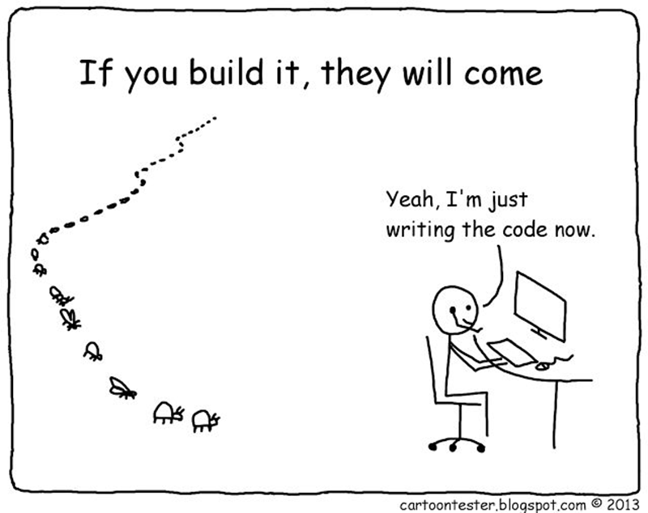
Arrrrrrrgh!!!!

Slide 9
Next topics
Variables
Functions

